Slide 1


Biases in RNA-Seq data October 15th, 2012 NBIC Advanced RNA-Seq course
Prof. dr. Antoine van Kampen
Bioinformatics Laboratory
Academic Medical Center
Biosystems Data Analysis Group
Swammerdam Institute for Life Sciences
a.h.vankampen@amc.uva.nl

Slide 2
Aim: to provide you with a brief overview of literature about biases in RNA-seq data such that you become aware of this potential problem (and solutions)

Slide 3
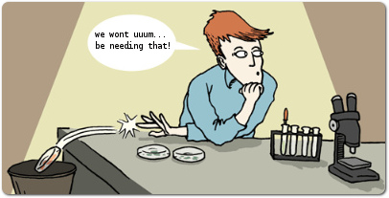
Example of RNA-seq bias.........

Slide 4
What is the problem?
Experimental (and computational) biases affect expression estimates and, therefore, subsequent data analysis:
Differential expression analysis
Study of alternative splicing
Transcript assembly
Gene set enrichment analysis
Other downstream analysis
We must attempt to avoid, detect and correct these biases

Slide 5
Types of bias
Gene length
Mappability of reads
e.g., due to sequence complexity
Position
Fragments are preferentially located towards either the beginning or end of transcripts
Sequence-specific
biased likelihood for fragments being selected
%GC

Slide 6
Few words about microarrays
Are not free of bias
It has taken a decade to understand these biases and to provide solutions
Recognition of biases (e.g., by the MicroArray Quality Control (MAQC) consortium) has led to the development of quality control standards
For RNA-Seq it will also take some time to "understand the data".
Comparison of microarrays and RNA-Seq may help to identify bias
Malone and Oliver (2011) BMC Biology, 9:34

Slide 7

Normalization for gene length and library size:
RPKM / FPKM

Slide 8
Within one sample
transcript 1 (size = L)
Count =6
transcript 2
(size=2L)
Count = 12
You can’t conclude that gene 2 has a higher expression than gene 1!

Slide 9
Comparison of two samples
transcript 1 (sample 1)
Count =6, library size = 600
transcript 1 (sample 2)
Count =12, library size = 1200
You can’t conclude that gene 1 has a higher expression in sample 2
compared to sample 1!

Slide 10
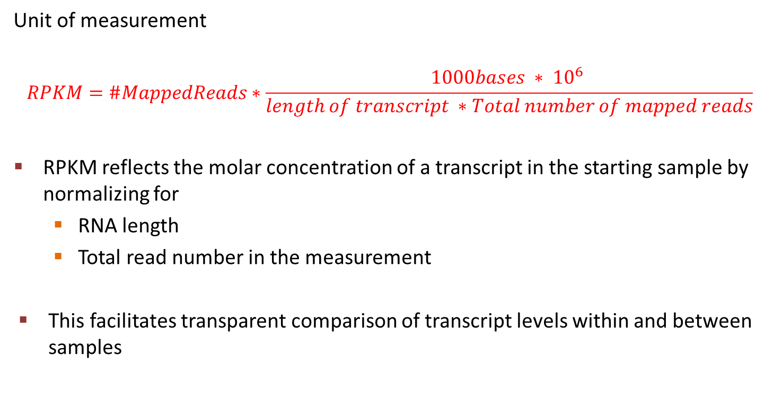
RPKM: Reads per kilobase per million mapped reads
Mortazavi et al (2008) Nature Methods, 5(7), 621

Slide 11
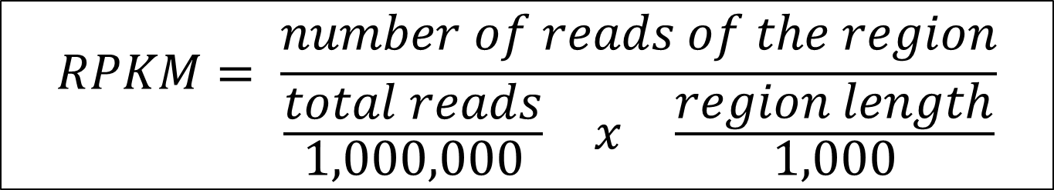
Rewriting the formula

Slide 12
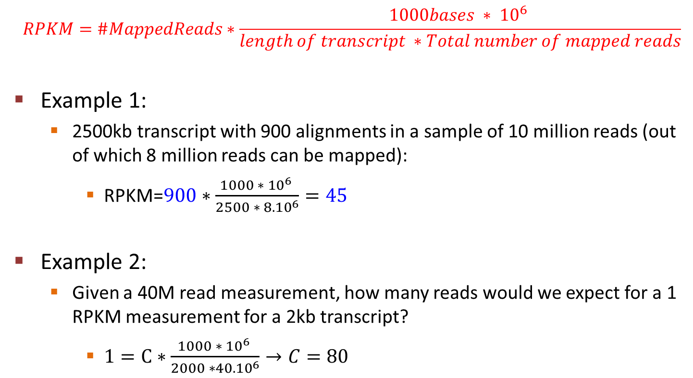
Examples

Slide 13
Examples

Slide 14
Examples

Slide 15
Examples

Slide 16
FPKM: Fragments per K per M
What's the difference between FPKM and RPKM?
Paired-end RNA-Seq experiments produce two reads per fragment, but that doesn't necessarily mean that both reads will be mappable. For example, the second read is of poor quality.
If we were to count reads rather than fragments, we might double-count some fragments but not others, leading to a skewed expression value.
Thus, FPKM is calculated by counting fragments, not reads.
Trapnell et al (2010) Nature Biotechnology, 28(5), 511

Slide 17
Other normalization methods
Housekeeping genes (Bullard et al, 2010)
Upper-quartile (Bullard et al, 2010). Counts are divided by (75th) upper-quartile of counts for transcripts with at least one read
TMM (Robinson and Oshlack, 2010). Trimmed Mean of M values
Quantile normalization (Irizarry et al, 2003; developed for microarrays)
Irizarry, et al (2003). Biostatistics (Oxford, England), 4(2), 249–64.
Bullard et al (2010) BMC bioinformatics, 11, 94.
Robinson & Oshlack (2010). Genome biology, 11(3), R25.

Slide 18




Trimmed Mean of M-values (TMM)
The total RNA production, S_{k}, cannot be estimated directly
we do not know the expression levels and true lengths of every gene.
Relative RNA production of two samples, f_{k} =S_{k}/_{Sk’}, essentially a global fold change, can more easily be determined.
➔ empirical strategy that equates the overall expression levels of genes between samples under the assumption that the majority of them are not differentially expressed.
Weighted trimmed mean of the log expression ratios (trimmed mean of M values (TMM); remove upper and lower x% of data):
normal M,A values:

Slide 19
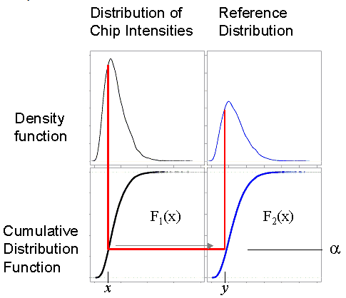
Quantile Normalization
http://www.people.vcu.edu/~mreimers/OGMDA/normalize.expression.html
Schematic representation of quantile normalization: the value x, which is the α-th quantile of all probes on chip 1, is mapped to the value y, which is the α quantile of the reference distribution F₂.
Notes:
Developed for affymetrix chips
In 2003, Benjamin Bolstad, one of Terry Speed’s students, proposed cutting through all the complexity by a simple non-parametric normalization procedure, at least for one-color arrays. He proposed to shoe-horn the intensities of all probes on each chip into one standard distribution shape, which he determined by pooling all the individual chip distributions. In practice, the distribution of intensities from any high-quality chip will do. The algorithm mapped every value on any one chip to the corresponding quantile of the standard distribution; hence the method is called quantile normalization. This simple 'between-chip' procedure worked as well as most of the more complex procedures then current, and certainly better than the regression method, which was then the manufacturer's default for Affymetrix chips. This method was also made available as the default in the affy package of Bioconductor, which has become the most widely used suite of freeware tools for microarrays (see www.bioconductor.org). For all these reasons quantile normalization has become the normalization procedure which I see most often in papers.

Slide 20
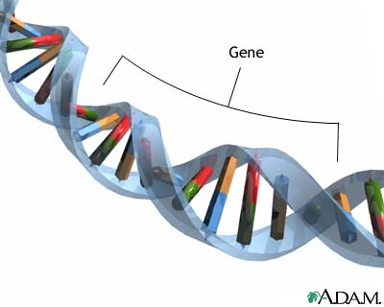
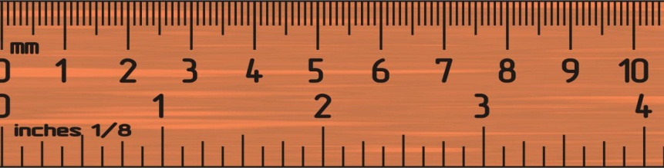
Gene length bias

Slide 21
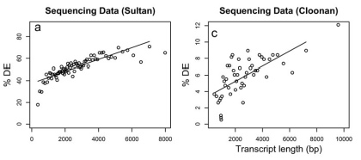
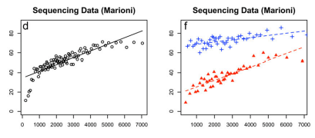
Gene length bias
This bias (a) affects comparison
between genes or isoforms
within one sample and (b) results
in more power to detect longer
transcripts
33% of highest expressed genes
33% of lowest expressed genes
Oshlack and Wakefield (2009) Biology Direct, 16, 4
Notes:
Data in these plots have not been normalized with RPKM!!
Current RNA-seq protocols use an mRNA fragmentation approach prior to sequencing to gain sequence coverage of the whole transcript. This means, in simple terms, that the total number of reads for a given transcript is propor-tional to the expression level of the transcript multiplied by the length of the transcript. In other words a long transcript will have more reads mapping to it compared to a short gene of similar expression. Since the power of an experiment is proportional to the sampling size, there is more power to detect differential expression for longer genes.
For each platform we first binned all genes into equal gene number bins based on their transcript length. Next we designated genes as differentially expressed (DE) based on a cut-off from the statistical procedure defined in the relevant publication.
From figure F: there is more bias for the lower expressed genes.

Slide 22

Question: does this bias disappear when we use RPKM?

Slide 23
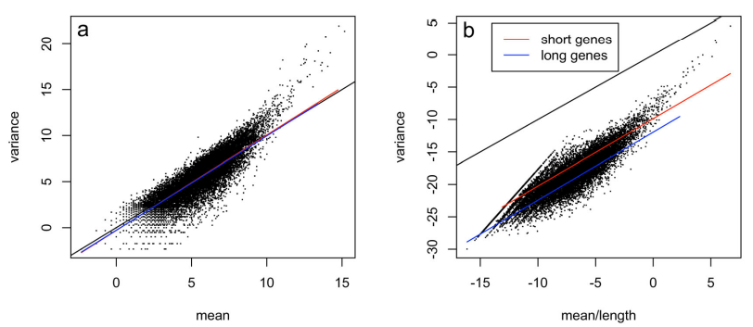
Mean-variance relationship
.
Sample variance across lanes in the liver sample from the Marioni et al (2008) Genome research, 18(9), 1509–17.
Red line: for the one third of shortest genes
Blue line: for the longest genes.
Black line: line of equality
Plot A: blue/red lines close to line of equality between mean and variance which is what would be expected from a Poisson process.
Notes:
This is what we expect from a Poisson process

Slide 24
Mean-variance relationship
variance
(log 2)
mean
mean / length
Plot B: Counts divided by gene length (which you do when using RPKM). The short genes have higher variance for a given expression level than long genes.
Because of the change in variance we are still left with a gene length dependency. → Thus, RPKM does not fully correct
Notes:
Since there is a gene length bias, one may correct for this by using RPKM. This will effectively divide by the gene length. However, this division also affects the mean-variance relationship. Before correction it is more or less as expected. After correction (Figure b) the relation is no longer Poisson distributed. And we see that the shorter genes now have a higher variance than the longer genes.

Slide 25
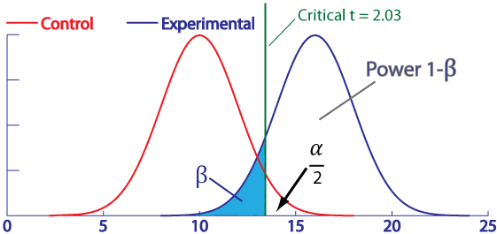
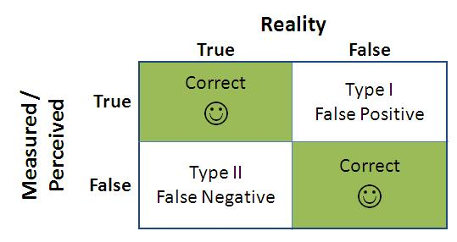
Just to refresh your memory

Slide 26


Power and gene length bias
More power to detect longer differentially expressed transcripts
L = gene length
Effect size.
Power is related to δ
In the paper they show that δ is still related to L after accounting for gene length

Slide 27
Gene set enrichment analysis and gene length bias
This bias affects Gene Set Enrichment analysis
In GSEA we compare sets of transcripts that are potentially of different length
For gene length corrections in this context see:
Gao et al (2011) Bioinformatics, 27(5), 662
Young et al (2010) Genome Biology, 11:R14
Correction at gene level or gene set level

Slide 28
Mappability bias

Slide 29
Mappability bias
Uniquely mapping reads are typically summarized over genomic regions
Regions with lower sequence complexity will tend to end up with lower sequence coverage
Test: generate all 32nt fragments from hg18 and align them back to hg18
Each fragment that cannot be uniquely aligned is unmappable and its first position is considered an unmappable position
Expect: uniform distribution
Schwartz et al (2011) PLoS One, 6(1), e16685

Slide 30

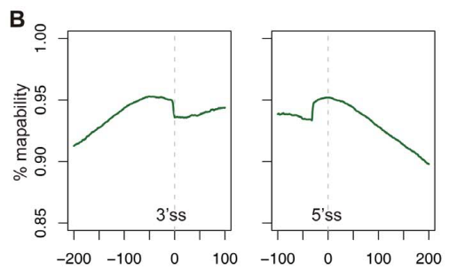
Result of test
Unexpected because introns
are assumed to have lower
sequence complexity in general
Since in RNA-seq we align reads prior to further analysis, this step may already introduce a (slight) bias.

Slide 31
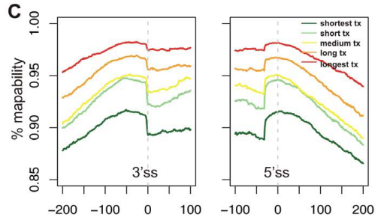
Mappability: dependency on transcript length
Reads corresponding to longer transcripts have a higher mappability

Slide 32
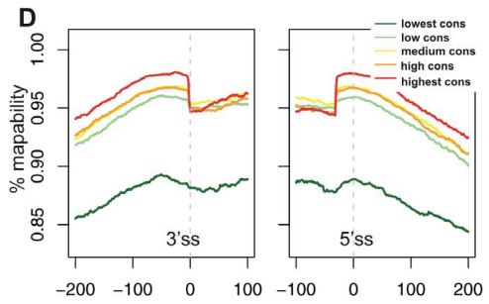
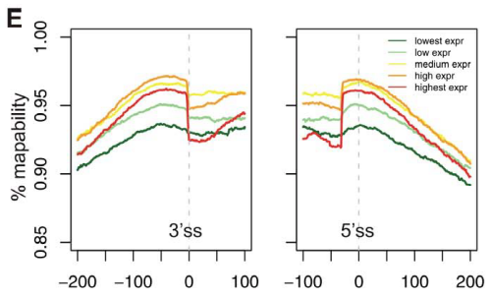
Mappability: evolutionary conservation and expression level
Note: expression level in
lung fibroblasts

Slide 33

Sequence-specific bias 1

Slide 34
RNA-Seq protocol
Current sequencers require that cDNA molecules represent partial fragments of the RNA
cDNA fragments are obtained by a series of steps (e.g., priming, fragmentation, size selection)
Some of these steps are inherently random
Therefore: we expect fragments with starting points approximately uniformly distributed over transcript.

Slide 35
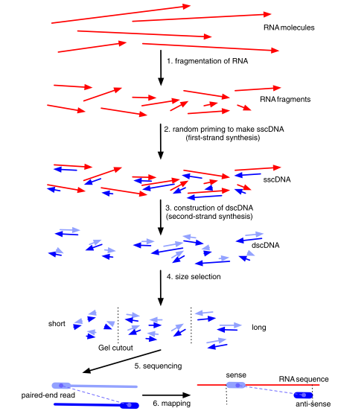
Roberts et al (2011). Genome biology, 12(3), R22.

Slide 36
Biases in Illumina RNA-seq data caused by hexamer priming
Generation of double-stranded complementary DNA (dscDNA) involves priming by random hexamers
To generate reads across entire transcript length
Turns out to give a bias in the nucleotide composition at the start (5’-end) of sequencing reads
This bias influences the uniformity of coverage along transcript
Hansen et al (2010) NAR, 38(12), e131
but also see:
Li et al (2010) Genome Biology, 11(5), R50
Schwartz et al (2011) PLoS One, 6(1), e16685
Roberts et al(2011) Genome Biology, 12: R22

Slide 37
position 1 in read
A
read (35nt)
transcript
A
position x in transcript
Determine the nucleotide frequencies considering all reads:
What do we expect??
Position in read
Nucl 1 2 3 4 5 ......... 35
A
C
G
T
We would expect that the frequencies for these nucleotides at the different
positions are about equal

Slide 38
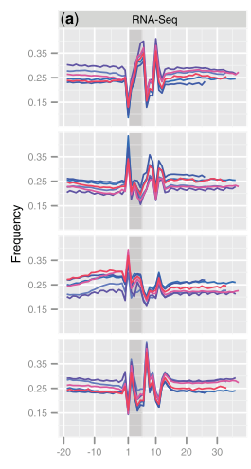
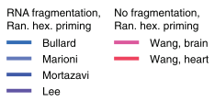
Bias
first hexamer = shaded
Frequencies slightly deviate between experiments but show identical relative behavior
Distribution after position 13 reflects nt composition of transcriptome
Effect is independent of study, laboratory, and organisms
Apparently, hexamer priming is not completely random
These patterns do not reflect sequencing error and cannot be removed by 5’ trimming!
Notes:
Figure 1. Nucleotide frequencies versus position for stringently mapped reads. For each experiment, mapped reads were extended upstream of the 50-start position, such that the first position of the actual read is 1 and positions 0 to -20 are obtained from the genome. The first hexamer of the read is shaded. (RNA-Seq experiments conducted using priming with random hexamers).
http://www.bio.davidson.edu/courses/genomics/method/randompriming.html
Random Hexamer Primer is a mixture of single-stranded random hexanucleotides with 5'- and 3'-hydroxyl ends.

Slide 39
Re-weighting scheme 1
Aim
Adjust biased nucleotide frequencies at the beginning of the reads to make them similar to distribution of the end of the reads (which is assumed to be representative for the transcriptome)
Approach
Associate weight with each read such that they
down- or up-weight reads with heptamer at beginning of read that is over/under-represented
Determine expression level of region by adjusting counts by
multiplying them with the weights

Slide 40

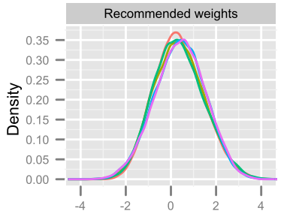

Re-weighting scheme 2
(assume read of at least 35nt)
= heptamer
Read
heptamers (h) at positions
i=1,2 of reads
heptamers (h) at positions
i=24..29 of reads
Weights are determined over all
possible 4⁷=16.384 heptamers
log(w)
Notes:
p(h) = proportion of reads that start with heptamer h

Slide 41
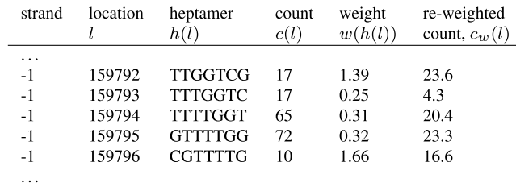
Application of re-weighting scheme
E.g., indicates that this heptamer (TTGGTCG) was under-represented,
thus count is up-weighted

Slide 42
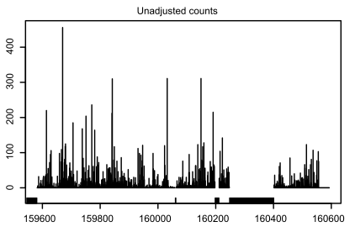
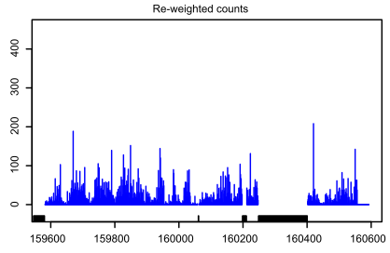
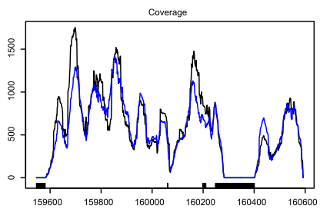
Example: gene YOL086C in yeast for WT experiment
unmapple bases
← Base level counts at each position
Extreme expression values are removed
but coverage is still far from uniform
Notes:
Figure 4. Evaluation of the reweighting scheme. Unadjusted and re-weighted base-level counts for reads from the WT experiment mapped to the sense strand of a 1-kb coding region in S. cerevisiae (YOL086C). The gray bars near the x-axis indicate unmappable genomic locations.
Stranded coverage plots were made by adding the weights of reads associated with each base in each stranded ROCE (weights of one for unadjusted counts). For such a standard coverage plot, each position of the read is assigned the same weight.
ROCE = bascially coding region

Slide 43

Sequence-specific bias 2

Slide 44
Explanation of next figure
(A) Sequence logos showing the distribution of nucleotides in a 23bp window surrounding the ends of fragments from an experiment primed with hexamers . The 3’-end sequences are complemented. Counts were taken only from transcripts mapping to single-isoform genes.
(B) Sequence logo showing normalized nucleotide frequencies after reweighting by initial (not bias corrected) FPKM in order to account for differences in abundance.
(C) The background distribution for the yeast transcriptome, assuming uniform expression of all single-isoform genes. The difference in 5’ en 3’ distributions are due to the ends being primed from opposite strands.
Comparing (C) to (A) and (B) shows that while the bias is confounded with expression in (A), the abundance normalization reveals the true bias to extend from 5bp upstream to 5bp downstream of the fragment end.
Taking the ratio of the normalized nucleotide frequencies (B) to the background (C) for the NNSR dataset gives bias weights (D), which further reveal that the bias is partially due to selection for upstream sequences similar to the strand tags, namely TCCGATCTCT in first-strand synthesis (which selects the 5’ end) and TCCGATCTGA in second-strand synthesis (which selects the 3’-end).
Roberts et al (2011) Genome Biology, 12:R22

Slide 45
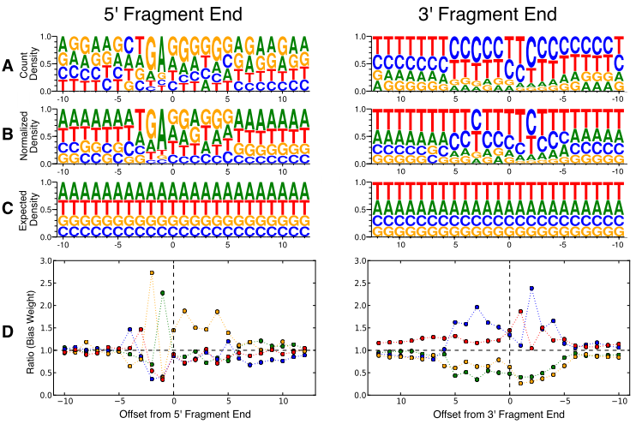
internal to fragment
Raw counts
FPKM
correction
Background
distribution

Slide 46
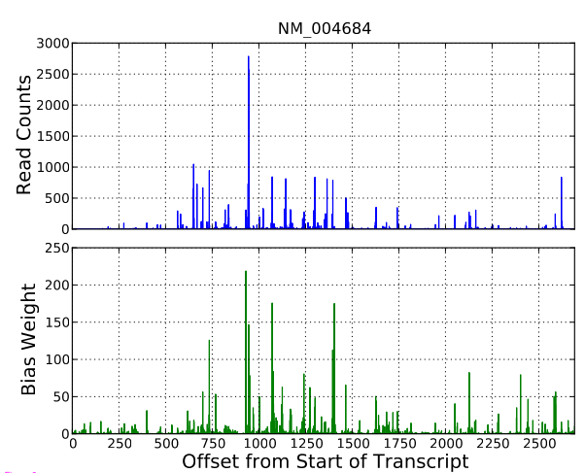
Bias correction
Use of statistical model that takes expression and nucleotide bias into account
non-uniform coverage of
raw read counts along transcript
Bias weights. Used to correct
raw read counts.
Large weights correspond to
positions with high count.
Notes:
Figure 3 Bias correction within transcripts. An example showing the effect of bias correction on the read counts for human transcript NM_004684. The top panel shows raw read counts (number of 3’ ends of fragments at each location), and the bottom panel shows the product of the bias parameters (total bias weight defined in the Supplementary methods in Additional file 3) at the same locations. We correctly identify bias at different positions and can therefore correct for the non-uniformity. Note that the bias parameters were learned from the entire dataset excluding reads mapped to this transcript in order to cross-validate our results. The RNA-Seq for the experiment was performed with the NSR protocol, which is why 3’ counts were used instead of 5’

Slide 47
Use of spike-in standards

Slide 48
Synthetic spike-in standards
External RNA Control Consortium (ERCC)
ERCC RNA standards
range of GC content and length
minimal sequence homology with endogenous transcripts from sequenced eukaryotes
FPKM normalization
Jiang (2011) Synthetic spike-in standards for
RNA-seq experiments. Genome Research
Notes:
The ERCC consortium synthesized RNAs by in vitro transcription
of de novo DNAsequences or of DNAderived from the B. subtilis or
the deep-sea vent microbe M. jannaschii genomes.

Slide 49
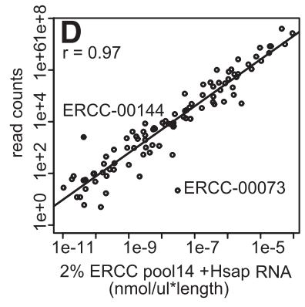
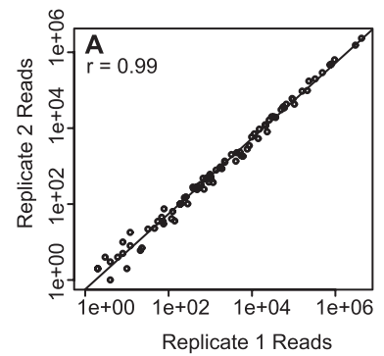
Results suggest systematic bias: better agreement between the observed read counts from replicates than between the observed read counts and expected concentration of ERCC’s within a given library.
Count versus concentration*length (mass) per ERCC. Pool of 44 2% ERCC spike-in H. Sapiens libraries
Read counts for each ERCC transcript in two different libraries of human RNA-seq with 2% ERCC spike-ins

Slide 50
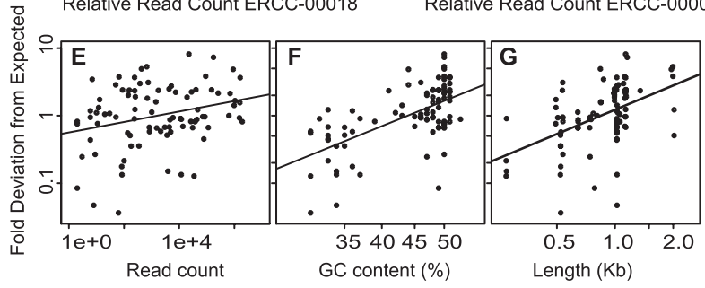
Transcript-specific sources of error
Fold deviation between observed and expected read count for each
ERCC in the 100% ERCC library
Fold deviation between observed and expected depends on
Read count
GC content
Transcript length
Transcript specific biases affect comparisons of read counts between different
RNAs in one library

Slide 51
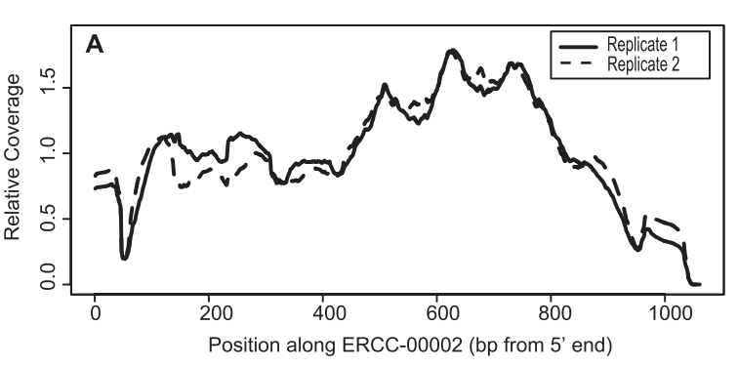
Read coverage biases: single ERCC RNA
Position effect
The ERCC RNAs are single isoform with well-defined ends Ideal for measuring transcript coverage

Slide 52
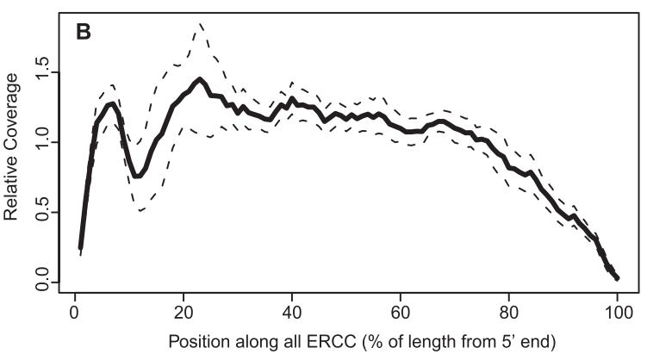
Read coverage biases: 96 ERCC RNAs
Suggested: drop in coverage at
3’-end due to the inherently
reduced number of priming
positions at the end of the
transcript
Position effect
Average relative coverage along all control RNAs for ERCC spiked in 44 H. sapiens libraries. Dashed lines represent 1 SD around the average across different libraries.

Slide 53
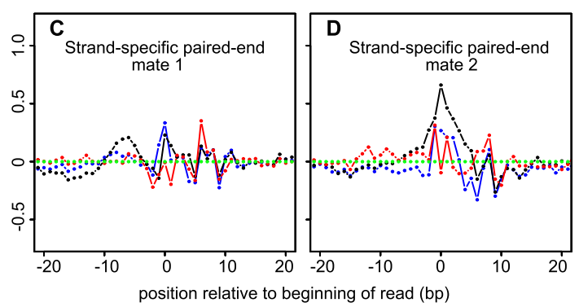

Read coverage biases: sequence-specific heterogeneity
Could be due to
RNA structure (single vs double-stranded template regions) and/or
Preparation of the RNA (e.g., nonrandom hydrolysis) or
cDNA synthesis (e.g., nonrandomness in “random” hexamer)
over/under
representation

Slide 54
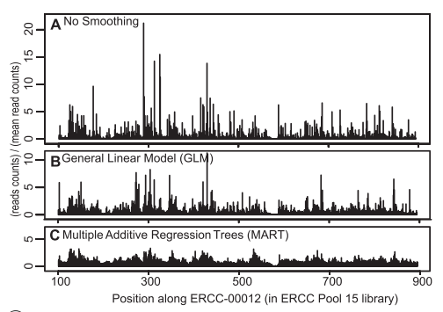
Read coverage biases: account for sequence-specific bias through statistical models
These models result
in a more even coverage

Slide 55
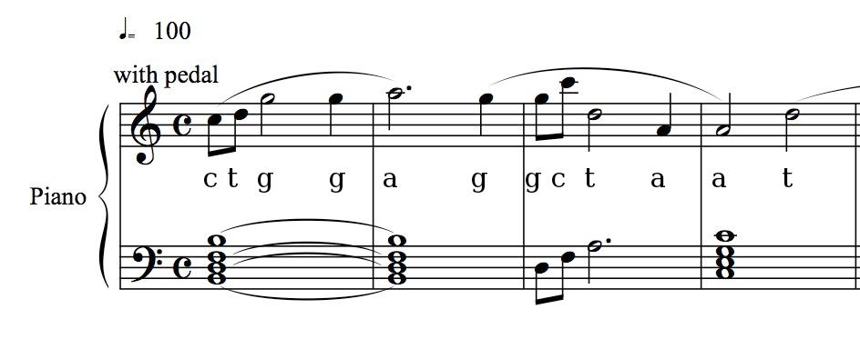
GC bias

Slide 56
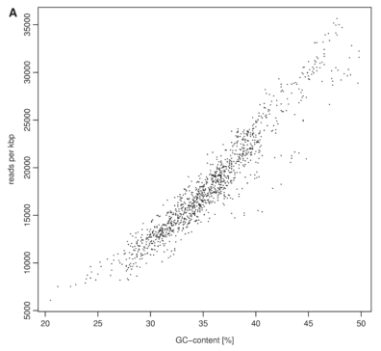
GC-bias in DNA-seq
Correlation of the Solexa read coverage and GC content. 27mer reads generated from Beta vulgaris BAC ZR-47B15.Each data point corresponds to the number of reads recorded for a 1-kbp window
This genome is GC poor
reads per
kbp
~linear relationship
Dohm et al (2008) NAR, 36, e105
GC content (%)
Notes:
Solexa is now Illumina

Slide 57
GC-bias in DNA-seq (1)
Benjamini & Speed (2012) Nucleic acids research, 40(10), e72.
Models for GC bias:
Fragmentation model
locally, GC counts could be associated with the stability of DNA and the modify the probability of a fragmentation point in the genome
Read model
GC content primarily modifies the base-sequencing process (GC explains read count)
Full-fragment model
GC content of full fragment determines which fragments are selected or amplified
Global model
GC effects on scales larger than the fragment length (e.g., higher-order DNA structure)
Notes:
These loosely defined models can be realized statistically by counting the GC in a suitable region and comparing that to fragment coverage.
This method is implemented as GCcorrect in R bioconductor package.

Slide 58
GC-bias in DNA-seq (2)
Conclusions from their study
Not a linear relationship (compare to Dohm et al, and Jiang et al). Instead unimodel relationship
Dependency between count and GC originates from a biased representation of possible DNA fragments (both high GC and high AT fragments being underrepresented)
PCR is the most important cause for GC bias
Not the GC content of the reads.
This dependency is consistent but the exact shape varies considerably across samples, even matched samples
They argue that models taking GC content and fragment length into account is also important for RNA-seq

Slide 59
GC-bias in DNA-seq (3)
Single position models
Estimate 'mean fragment count' (rate) for individual locations rather than bins.
Link fragment count to GC content

Slide 60

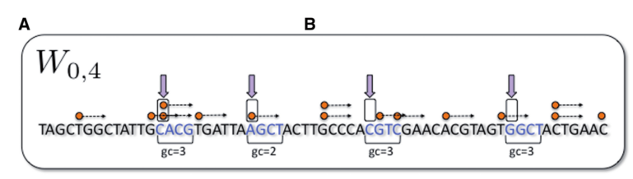
Single Position Model (1)
Mappaple positions along genome are randomly sampled (n~10 million)
Fragment
5'-end
count #fragments with
5'-end in sampled
positions
Determine GC count in
corresponding sliding window W_{0,4}
(depends on genome not on read)
Notes:
The sliding window Wa,l is characterized by the offset a and length l

Slide 61

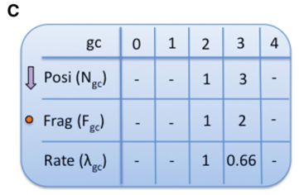
Single Position Model (2)
S_{gc} = stratum with gc=GC(x+a,l) (x=position, a=shift, l=length)
N_{gc} = number of sample positions assigned to S_{GC}
F_{gc} = number of fragments starting (5'-end) at the x's in S_{gc}
Estimate λ_{gc} by
Notes:
The sliding window Wa,l is characterized by the offset a and length l
Fgc/Ngc down-wweights the rate if many positions are assigned to specific stratum (=%GC) because this wouldn't be expected if there was no bias.

Slide 62
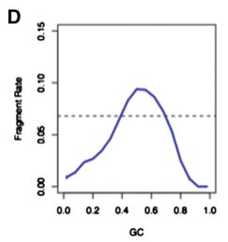
Single Position Model (3)
unimodel

Slide 63


Model comparison
Estimated model W_{a,l} (i.e., choice of GC window)
Used to generate predicted counts for any genomic region
Comparison of models (i.e., different a, l) through TV (0<= TV <= 1)
normalized total variation distance
distance between stratified estimated rates W_{a,l} and uniform rate (U)
global mean rate (n=sampled positions, F=total number of mapped fragments)
We look for high TV: counts are strongly dependent on GC

Slide 64

Fragment length models
To measure effect of fragment lengths
Fragment length model = single position model
but counting fragments of length s only
Determine model W^{s}_{a,l}
only count fragments of length s starting at x's in S_{gc}
Model the count of fragments using GC in the fragment (not in fixed window of length l)
To reduce impact of local biases a few base pairs from the ends of the fragments are removed: W^{s}_{a,s-a-m}
GC window grows with fragment length
In this model we have parameters GC and fragment length

Slide 65

Predicted rates
For example, W_{a=0,l=25}
5 reads
4 reads
3 reads
DNA
window l
and gc=5
F = 12
N = 4
mean fragment rate = 12/4 = 3 (we are just averaging)
predicted rate for %GC
Notes:
See corresponding excel sheet for an example as how to subsequently correct for GC bias on a position-by-position basis.

Slide 66


Evaluation
The success of a model (W_{a,l}) is evaluated by comparing its predictions with the observed fragment counts
For robust evaluation use Mean Absolute Deviation (MAD)
B is set of bins (i.e., non-overlapping windows on genome)
F_{b} the count of fragments for which 5'-end is inside bin b.
Normalization. (CN=copy number, e=0.1 account for
small counts)

Slide 67
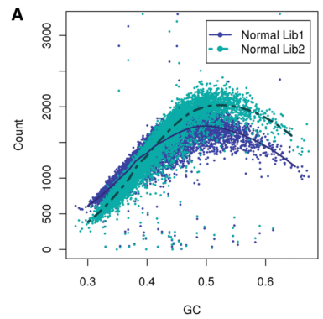
Results (1) – Bin counts
Two different libraries from same starting DNA
10 kb bins
Unimodal relation
Same trend but the curves are not aligned.
This makes a case for single sample
normalization'
Notes:
Figure 2. GC curves (10 kb bins). Observed fragment counts and loess lines plotted against GC of two libraries from the same normal sample. Counts and curves of all libraries are scaled to fit median counts of normal library 1. Bins were randomly sampled from chromosome 1, and counts include fragments from both strands.

Slide 68
Results (2) – Single position models
Compare different GC windows throught TV
a=0, different lengths l
Expection:
strongest effect after a few bp (fragmentation effect)
after 30-75 bp (read effect)
at the fragment length (full-fragment effect)

Slide 69
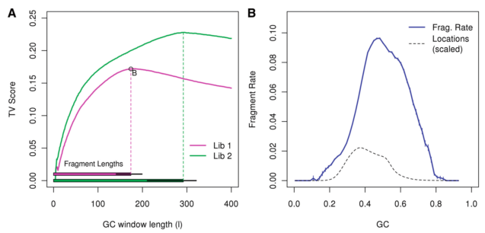
Strongest effect (TV score) coincides with fragment length (W_{0,180} and W_{0,295})
Corresponding GC curve is very sharp
bars on the bottom (left panel): median and 0.05/0.95 quantiles
Notes:
Figure 3. Single position models. (A) The top curves represent TV scores for GC windows of different lengths, all beginning at 0 (a=0). The horizontal bars on the bottom mark the median fragment lengths (and 0.05, 0.95 quantiles). For each library, the strongest GC windows are those that encompass the full fragment. For library 1, we mark the optimal model (W0,180), and show its resulting GC curve on the right panel (B). (We actually show W2,176, removing 2 bp from each side of the fragment.) The GC curve measures the fragment rate given the fraction of GC in the window. Vertical lines (blue) represent 1 SD. For comparison, we plot the distribution of GC (dotted line) in our sample from chromosome 1 (scaled).

Slide 70
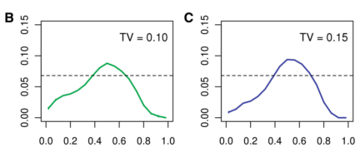
Results (3) – Single position models
Smaller scales (l=50bp) allows to compare GC window that overlaps with read with a GC window that does not
W_{0,50} versus W_{75,50}
Effect of 'read' model is not as large as 'fragment center' model
May imply that bias is not driven by base calling or sequencing effects but by the composition of the full fragment
Notes:
Figure 4. Different lags. (A) GC curve of the window before the fragment, W50,50;(B) within the read, W0,50 and (C) in the fragment center, not overlapping the read, W75,50.(D) A plot of TV scores for 50 bp sliding windows (Wa,50). The x-axis marks a, the location of the window 50-end
relative to 50-end of the fragment. On the bottom, we mark a fragment and its reads in relation to the GC windows from the top panels.

Slide 71
Results (4) – Results of fragment length
Length of fragment influences shape of the GC curve
Interaction between GC and length
Long fragments tend to have a higher GC count
Notes:
Figure 4. Different lags. (A) GC curve of the window before the fragment, W50,50;(B) within the read, W0,50 and (C) in the fragment center, not overlapping the read, W75,50.(D) A plot of TV scores for 50 bp sliding windows (Wa,50). The x-axis marks a, the location of the window 50-end
relative to 50-end of the fragment. On the bottom, we mark a fragment and its reads in relation to the GC windows from the top panels.

Slide 72
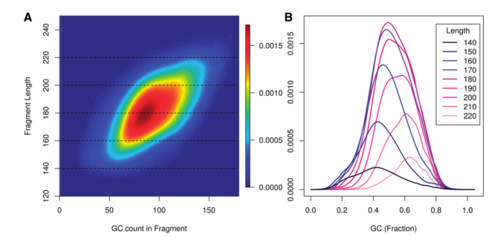
GC-content bias
Notes:
Fragment rate by length and GC. (A) A heat map describes rates for each (GC, length) pair. Each dotted line represents a single length. In (B), GC curves for fragments of specific lengths are drawn [corresponding to the dotted lines in (A)]. Blue / dark curves represent shorter fragments than red / bright. Here x-axis is the fraction of GC.

Slide 73
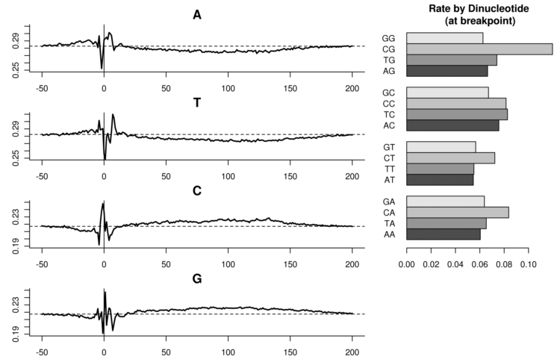
Results (5) – Fragmentation effect
Sequence specific bias (as also observed in RNAseq experiments)
Notes:
Figure 6. Fragmentation effect. Left: relative abundance of nucleotides at fixed positions relative to fragment 50-end. A horizontal dotted line marks the relative abundance of the base at mappable positions. Right: fragment rates when stratifying by the dinucleotide (1,0). Dinucleotide counts overlapping the fragment 50-end.

Slide 74
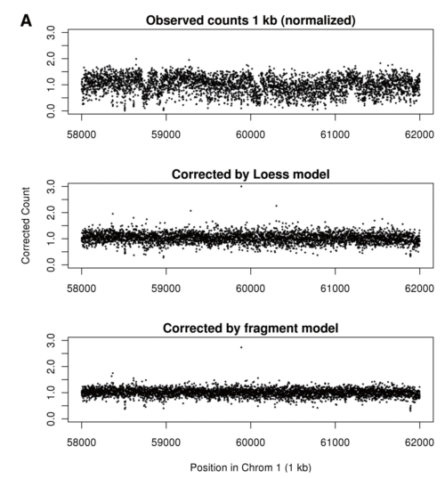
Results (6) – read count correction
The authors conclude that the fragment model best explains the counts (see figure 7 in paper)
However, not including fragment length
(thus W(a,l ) instead of W(a,s)

Slide 75
Some other stuff.......

Slide 76
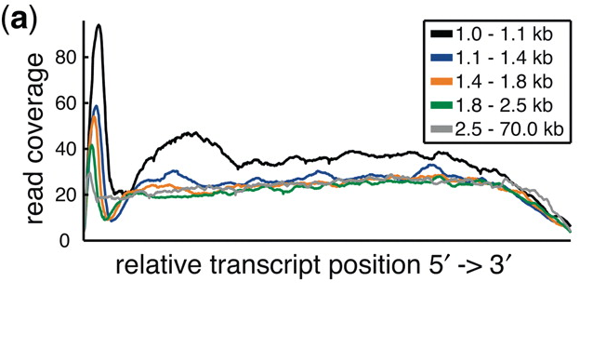
Technical bias: cDNA library preparation
Bohnert et al, Nucleic Acids Res (2010)
Notes:
Normalized read coverage with respect to the relative transcript position is shown grouped by five different transcript length bins for the C. elegans SRX001872 data set

Slide 77
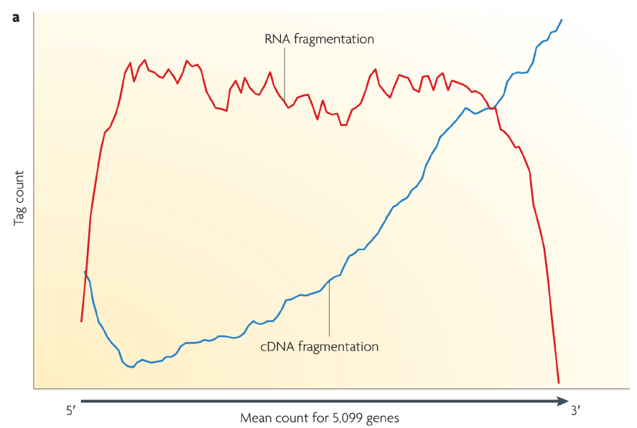
Technical bias: cDNA library preparation
DNA library preparation: RNA fragmentation and cDNA fragmentation compared Fragmentation of oligo-dT primed cDNA (blue line) is more biased towards the 3′ end of the transcript. RNA fragmentation (red line) provides more even coverage along the gene body,
but is relatively depleted for both the 5′ and 3′ ends.
Wang et al (2009) Nature reviews. Genetics, 10(1), 57–63.

Slide 78
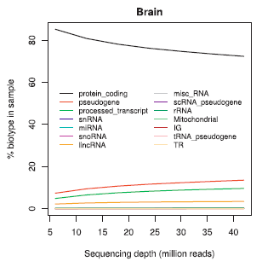
RNAseq may detect other RNA species (1)
Tarazona et al (2011) Genome research, 21(12), 2213–23

Slide 79
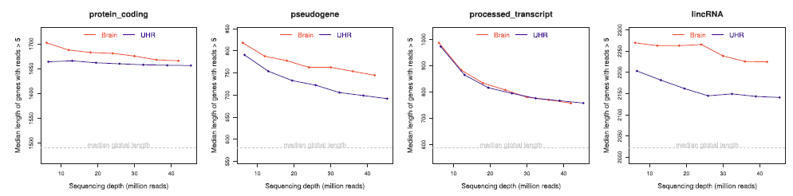
RNAseq may detect other RNA species (2)
median transcript length in Brain and UHR samples (MAQC) versus read depth
protein coding pseudo gene processed transcript lincRNA
Read depth
Tarazona et al (2011) Genome research, 21(12), 2213–23

Slide 80
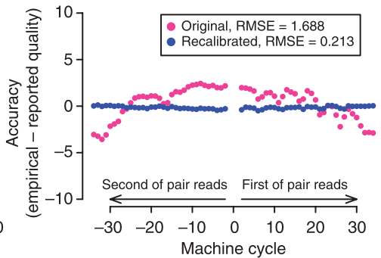
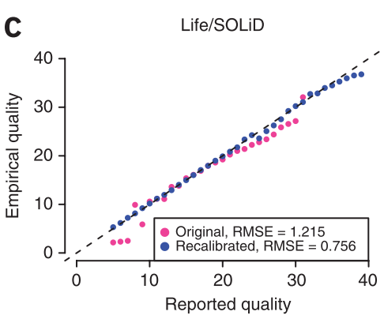

Incorrect base quality values
Work of DePristo et al in context of genotyping (exome/genome sequencing)
DePristo et al. (2011). Nature genetics, 43(5), 491–8.
Notes:
DePristo, M. a, Banks, E., Poplin, R., Garimella, K. V., Maguire, J. R., Hartl, C., Philippakis, A. a, et al. (2011). A framework for variation discovery and genotyping using next-generation DNA sequencing data. Nature genetics, 43(5), 491–8.
Figure 3 Raw (pink) and recalibrated (blue) base quality scores for NGS paired-end read set of Life/SOLiD. The top panel shows reported base quality scores compared to the empirical estimates; the middle panel shows the difference between the average reported and empirical quality score for each machine cycle, with positive and negative cycle values given for the first and second read in the pair, respectively; and the bottom panel shows the difference between reported and empirical quality scores for each of the 16 genomic dinucleotide contexts. For example, the AG context occurs at all sites in a read where G is the current nucleotide and A is the preceding one in the read. Root-mean-square errors (RMSE) are given for the pre- and post-recalibration curves.

Slide 81
And more....
Jones, D. C., Ruzzo, W. L., Peng, X., & Katze, M. G. (2012). A new approach to bias correction in RNA-Seq. Bioinformatics (Oxford, England), 28(7), 921–8.
Risso, D., Schwartz, K., Sherlock, G., & Dudoit, S. (2011). GC-content normalization for RNA-Seq data. BMC bioinformatics, 12(1), 480.
Sendler, E., Johnson, G. D., & Krawetz, S. a. (2011). Local and global factors affecting RNA sequencing analysis. Analytical biochemistry, 419(2), 317–22.
Vijaya Satya, R., Zavaljevski, N., & Reifman, J. (2012). A new strategy to reduce allelic bias in RNA-Seq readmapping. Nucleic acids research, 40(16), e127.
Zheng, W., Chung, L. M., & Zhao, H. (2011). Bias detection and correction in RNA-Sequencing data. BMC bioinformatics, 12, 290.
Tools
Wang, L., Wang, S., & Li, W. (2012). RSeQC: quality control of RNA-seq experiments. Bioinformatics (Oxford, England), 28(16), 2184–5.
DeLuca, D. S., Levin, J. Z., Sivachenko, A., Fennell, T., Nazaire, M.-D., Williams, C., Reich, M., et al. (2012). RNA-SeQC: RNA-seq metrics for quality control and process optimization. Bioinformatics (Oxford, England), 28(11), 1530–2.
Picard tools

Slide 82
Benjamini, Y., & Speed, T. P. (2012). Summarizing and correcting the GC content bias in high-throughput sequencing. Nucleic acids research, 40(10), e72. doi:10.1093/nar/gks001
Bohnert, R., & Rätsch, G. (2010). rQuant.web: a tool for RNA-Seq-based transcript quantitation. Nucleic acids research, 38(Web Server issue), W348–51. doi:10.1093/nar/gkq448
Bullard, J. H., Purdom, E., Hansen, K. D., & Dudoit, S. (2010). Evaluation of statistical methods for normalization and differential expression in mRNA-Seq experiments. BMC bioinformatics, 11, 94. doi:10.1186/1471-2105-11-94
DeLuca, D. S., Levin, J. Z., Sivachenko, A., Fennell, T., Nazaire, M.-D., Williams, C., Reich, M., et al. (2012). RNA-SeQC: RNA-seq metrics for quality control and process optimization. Bioinformatics (Oxford, England), 28(11), 1530–2. doi:10.1093/bioinformatics/bts196
Dohm, J. C., Lottaz, C., Borodina, T., & Himmelbauer, H. (2008). Substantial biases in ultra-short read data sets from high-throughput DNA sequencing. Helicobacter, 36(16). doi:10.1093/nar/gkn425
Gao, L., Fang, Z., Zhang, K., Zhi, D., & Cui, X. (2011). Length bias correction for RNA-seq data in gene set analyses. Bioinformatics (Oxford, England), 27(5), 662–9. doi:10.1093/bioinformatics/btr005
Hansen, K. D., Brenner, S. E., & Dudoit, S. (2010). Biases in Illumina transcriptome sequencing caused by random hexamer priming. Nucleic acids research, 38(12), e131. doi:10.1093/nar/gkq224
Hansen, K. D., Irizarry, R. a, & Wu, Z. (2012). Removing technical variability in RNA-seq data using conditional quantile normalization. Biostatistics (Oxford, England), 13(2), 204–16. doi:10.1093/biostatistics/kxr054
Jiang, L., Schlesinger, F., Davis, C. a, Zhang, Y., Li, R., Salit, M., Gingeras, T. R., et al. (2011). Synthetic spike-in standards for RNA-seq experiments. Genome research, 21(9), 1543–51. doi:10.1101/gr.121095.111
Jones, D. C., Ruzzo, W. L., Peng, X., & Katze, M. G. (2012). A new approach to bias correction in RNA-Seq. Bioinformatics (Oxford, England), 28(7), 921–8. doi:10.1093/bioinformatics/bts055
Malone, J. H., & Oliver, B. (2011). Microarrays, deep sequencing and the true measure of the transcriptome. BMC biology, 9, 34. doi:10.1186/1741-7007-9-34
Mortazavi, A., Williams, B. A., McCue, K., Schaeffer, L., & Wold, B. (2008). Mapping and quantifying mammalian transcriptomes by RNA-Seq. Nature methods, 5(7), 621–8. doi:10.1038/nmeth.1226
Oshlack, A., & Wakefield, M. J. (2009). Transcript length bias in RNA-seq data confounds systems biology. Biology direct, 4, 14. doi:10.1186/1745-6150-4-14
Risso, D., Schwartz, K., Sherlock, G., & Dudoit, S. (2011). GC-content normalization for RNA-Seq data. BMC bioinformatics, 12(1), 480. doi:10.1186/1471-2105-12-480
Roberts, A., Trapnell, C., Donaghey, J., Rinn, J. L., & Pachter, L. (2011). Improving RNA-Seq expression estimates by correcting for fragment bias. Genome biology, 12(3), R22. doi:10.1186/gb-2011-12-3-r22
Robinson, M. D., & Oshlack, A. (2010). A scaling normalization method for differential expression analysis of RNA-seq data. Genome biology, 11(3), R25. doi:10.1186/gb-2010-11-3-r25
Schwartz, S., Oren, R., & Ast, G. (2011). Detection and removal of biases in the analysis of next-generation sequencing reads. PloS one, 6(1), e16685. doi:10.1371/journal.pone.0016685
Sendler, E., Johnson, G. D., & Krawetz, S. a. (2011). Local and global factors affecting RNA sequencing analysis. Analytical biochemistry, 419(2), 317–22. doi:10.1016/j.ab.2011.08.013
Tarazona, S., García-Alcalde, F., Dopazo, J., Ferrer, A., & Conesa, A. (2011). Differential expression in RNA-seq: a matter of depth. Genome research, 21(12), 2213–23. doi:10.1101/gr.124321.111
Trapnell, C., Williams, B. A., Pertea, G., Mortazavi, A., Kwan, G., van Baren, M. J., Salzberg, S. L., et al. (2010). Transcript assembly and quantification by RNA-Seq reveals unannotated transcripts and isoform switching during cell differentiation. Nature biotechnology, 28(5), 511–5. doi:10.1038/nbt.1621
Vijaya Satya, R., Zavaljevski, N., & Reifman, J. (2012). A new strategy to reduce allelic bias in RNA-Seq readmapping. Nucleic acids research, 40(16), e127. doi:10.1093/nar/gks425
Wang, L., Wang, S., & Li, W. (2012). RSeQC: quality control of RNA-seq experiments. Bioinformatics (Oxford, England), 28(16), 2184–5. doi:10.1093/bioinformatics/bts356
Wang, Z., Gerstein, M., & Snyder, M. (2009). RNA-Seq: a revolutionary tool for transcriptomics. Nature reviews. Genetics, 10(1), 57–63. doi:10.1038/nrg2484
Young, M. D., Wakefield, M. J., Smyth, G. K., & Oshlack, A. (2010). Gene ontology analysis for RNA-seq: accounting for selection bias. Genome biology, 11(2), R14. doi:10.1186/gb-2010-11-2-r14
Zheng, W., Chung, L. M., & Zhao, H. (2011). Bias detection and correction in RNA-Sequencing data. BMC bioinformatics, 12, 290. doi:10.1186/1471-2105-12-290
• Zheng, W., Chung, L. M., & Zhao, H. (2011). Bias detection and correction in RNA-Sequencing data. BMC bioinformatics, 12, 290. doi:10.1186/1471-2105-12-290

Slide 83
To conclude
Be aware of different types of bias
Try to avoid
Try to detect
Try to correct

